Slide 1


IP ADDRESS FINDER
REVIEW -2 Design and Analysis of Algorithm Project

Slide 2


Team Members
AFRAZ TANVIR (RA2011003010499)
ANKUSH SAHOO (RA2011003010531)
SHANSHANK SINGH (RA2011003010541)

Slide 3
Contents
INTRODUCTION
BASIC PRINCIPLE
PROBLEM DEFINITION
DESIGN METHODOLOGY
OUTPUT
TIME COMPLEXITY ANALYSIS
CONCLUSION
REFERENCES

Slide 4
Project Definition
To make an algorithm which can search through a data as fast as possible. To use splay tree (fastest data structure) to achieve the aim.

Slide 5
Introduction
With the help of splay tree data structure, we would create a tree whose nodes are embedded with the Ip address of the device that are connect to a specific network router.
In our code we have taken 11 devices connected to one network router and so there would be some common part in the Ip address of each of the devices.
Now, router gets some specific data packets from the net which is supposed to be given to a specified device and so it uses searching operation to find the correct Ip address.
To increase the speed of this process we use splay tress for searching and inserting the Ip addresses. It is the fastest data structure for searching operation.
Therefore, the router sends the data packet to the specified Ip address when multiple devices are connected.
Here we have used the random function to input the data packets so that there is no input function required and the processes is completely automatic as it takes place in network router.

Slide 6
Basic Principle
It uses the principle that the most occurring Ip address stays at the top and so the time complexity of searching decreases eventually.

Slide 7
Design Methodology
To keep the most recurring element on the root node the data structure uses splaying operation.
We will use greedy method to perform splaying.
The main idea of splay tree is to bring the recently accessed item to root of the tree, this makes the recently searched item to be accessible in O(1) time if accessed again.
The idea is to use locality of reference (In a typical application, 80% of the access are to 20% of the items). Imagine a situation where we have millions or billions of keys and only few of them are accessed frequently, which is very likely in many practical applications.

Slide 8
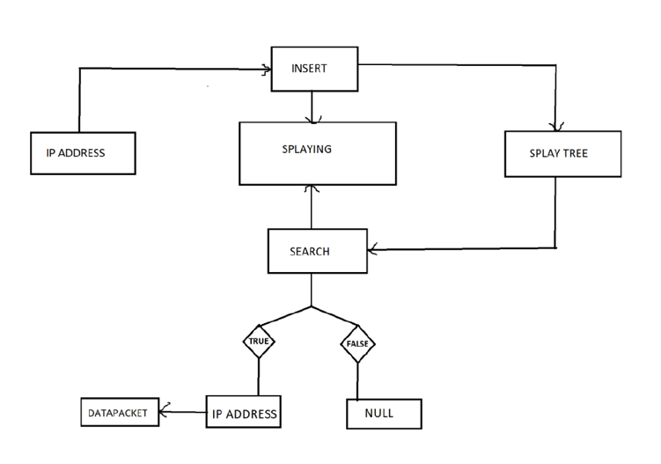
Block Diagram

Slide 9
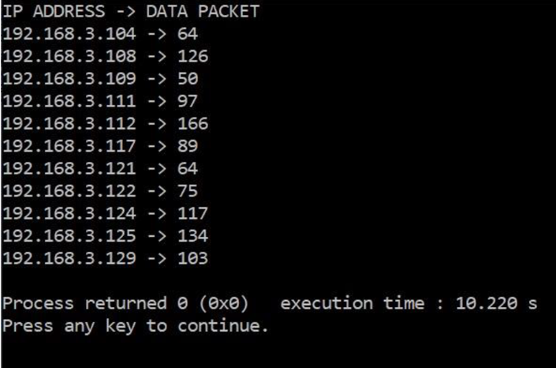
Output

Slide 10
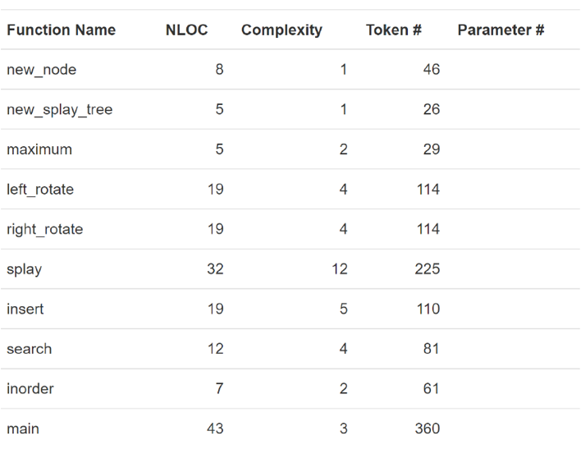
Time Complexity Analysis

Slide 11
Time Complexity Analysis
All splay tree operations run in O(log n) time on average, where n is the number of entries in the tree. Any single operation can take Theta(n) time in the worst case.

Slide 12
Conclusion
The algorithm was successfully designed which makes searching fast was successfully designed. When multiple devices are connected in one router and millions of data packets are being sent in time of seconds, splay tree is the most convenient data structure to be used in such fields.

Slide 13
References
GEEKS FOR GEEKS
TUTORIAL POINTS
CODEFORCES
Thomas H cormen, Charles E Leiserson, Ronald L Revest, Clifford Stein, Introduction to Algorithms, 3rd., The MIT Press Cambridge, 2014

Slide 14
Thank You
AFRAZ TANVIR (RA2011003010499)
ANKUSH SAHOO (RA2011003010531)
SHANSHANK SINGH (RA2011003010541)

